Slide 1
Evaluating Regression Model
There are 3 main evaluation metrics of the linear Regression model
MSE: Mean Squared Error
RMSE: Root mean Squared Error
R Square
Adjusted R Square

Slide 2
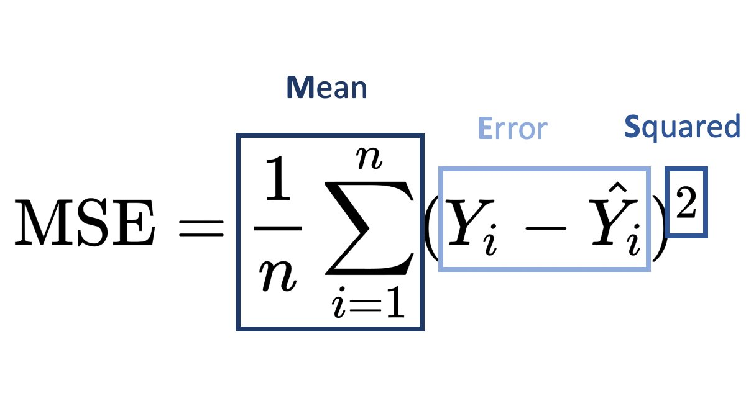
MSE : Mean Square Error
It is used as loss/cost function in linear Regression model

Slide 3
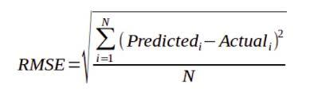
RMSE : Root Mean Square error
RMSE is the square root of MSE. MSE is measured in units that are the square of the target variable, while RMSE is measured in the same units as the target variable. Due to its formulation, MSE, just like the squared loss function that it derives from, effectively penalizes larger errors more severely

Slide 4
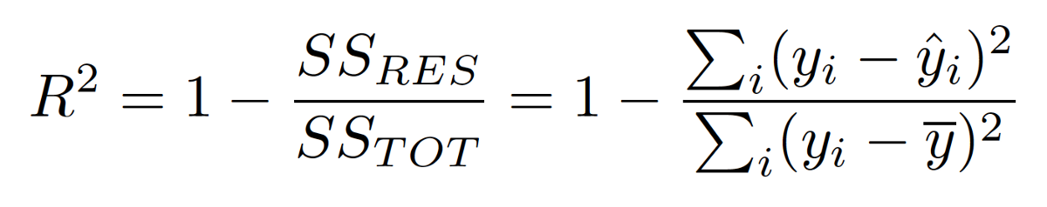
R Square
the coefficient of determination, denoted R² or r² and pronounced "R squared", is the proportion of the variation in the dependent variable that is predictable from the independent variable(s).

Slide 5
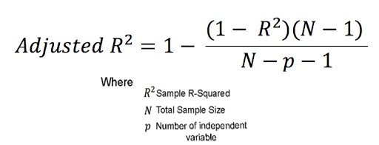
Adjusted R Square
Adjusted R-squared is a modified version of R-squared that has been adjusted for the number of predictors in the model. The adjusted R-squared increases when the new term improves the model more than would be expected by chance. It decreases when a predictor improves the model by less than expected

Slide 6
R square vs Adjusted R Square
R-square have some disadvantages that are overcome by Adjusted R-Square. The R-Square value keeps increasing even if you add features that are not related to the target variable. Adjusted R-Square value increases only if that feature is related to the target variable.

Slide 7
Regularization
When we use the Linear Regression model there are chances that the model will overfit the given training data set. Regularization helps in reducing overfitting by penalizing coefficients.
There are three main regularization techniques in Linear Regression :
L1: LASSO (Least Absolute Shrinkage Selector Operator)
L2: Ridge
Elastic Net

Slide 8
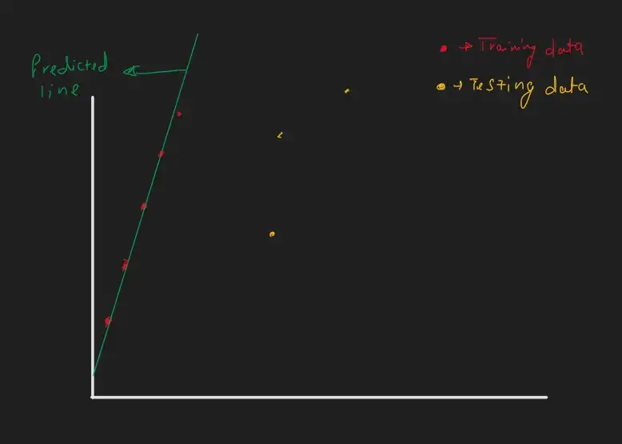
First, we will try to understand the causes of overfitting in the linear regression model.
When the model is going to have too many parameters and model parameters are having high values then it is said to be a complex model.
If the model is complex, it will have high Variance (Sensitivity ), resulting in overfitting.
The line fits perfectly to training data but not too testing data. The model is not generalized. Linear Regression model is having m (slope)value to be high as the slope of the line is high so this result in a high variance model.
In y=mx+c if the m value is higher than the small change in x there is a big change in y. if the slope of the line would have less in that case there would be less overfitting
Regularization will help to reduce m value. so if we succeed in decreasing the m value we can make the model more generalized.

Slide 9
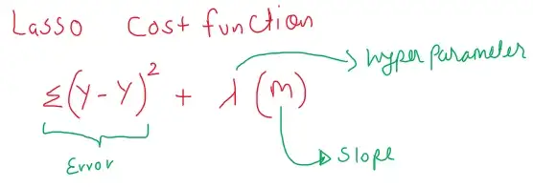
L1: LASSO (Least Absolute Shrinkage Selector Operator)
Lasso Cost Function =Sum of Error + Sum of the absolute value of coefficients.
LASSO Cost function will find a predicted line which is having less m value and also less error. It can also eliminate some features by making the m value zero.

Slide 10
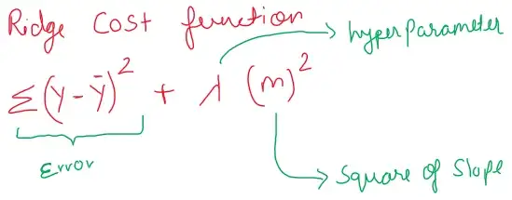
L2: Ridge
Ridge cost function: Sum of Error + Sum of the squares of coefficients
Ridge shrink the parameter it helps in preventing multi collinearity.

Slide 11
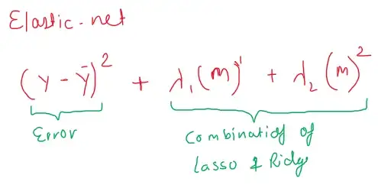
Elastic Net
Elastic net uses the combination of LASSO & Ridge.
Elastic net: Sum of errors + Sum of the absolute value of coefficients + Sum of the squares of coefficients.

Slide 12
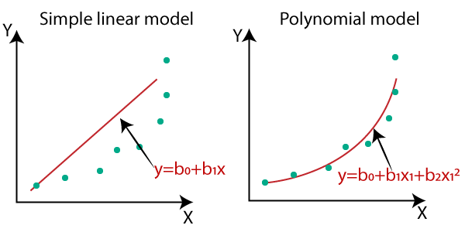
Polynomial Regression

Slide 13
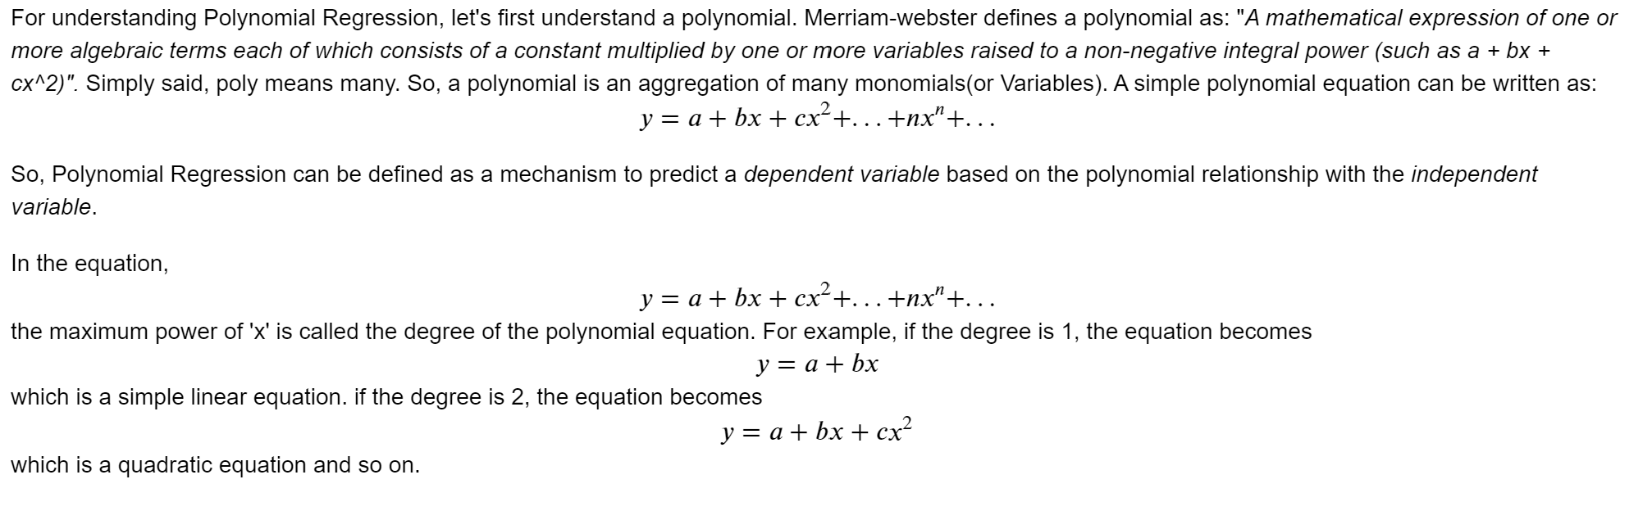
Polynomial Regression

Slide 14
Logistic Regression (Logit Regression)
It is often used for classification and it estimates the probability of an event
for logistic regression, we calculate probability, i.e. y is the probability of a given variable x belonging to a certain class. Thus, it is obvious that the value of y should lie between 0 and
For linear regression, the model is defined by: 𝑦=𝛽0+𝛽1𝑥 - (i)
But, when we use equation(i) to calculate probability, we would get values less than 0 as well as greater than 1. That doesn’t make any sense . So, we need to use such an equation which always gives values between 0 and 1, as we desire while calculating the probability.
We use the sigmoid function as the underlying function in Logistic regression

Slide 15
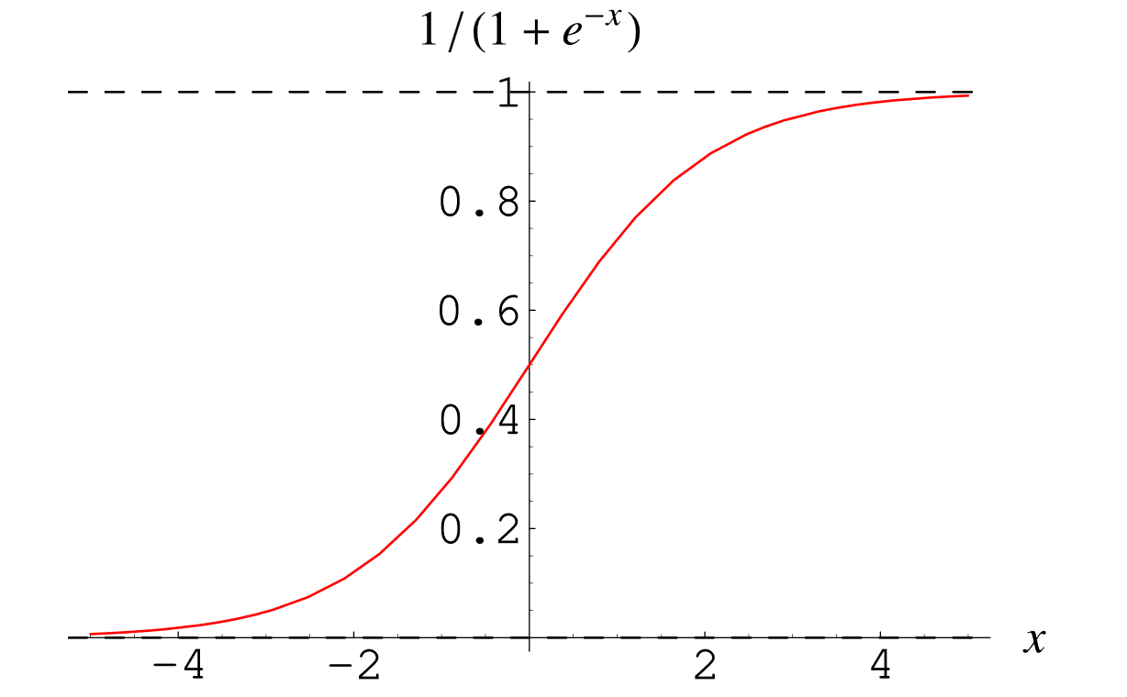
Sigmoid Function
Why do we use the Sigmoid Function?
The sigmoid function’s range is bounded between 0 and 1. Thus it’s useful in calculating the probability for the Logistic function.
It’s derivative is easy to calculate than other functions which is useful during gradient descent calculation.
It is a simple way of introducing non-linearity to the model.

Slide 16
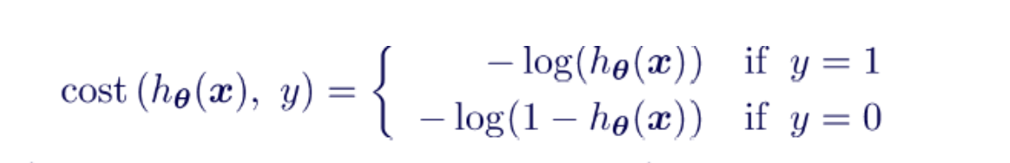
Cost / Loss function
The cost function used in Logistic Regression is Log Loss.

Slide 17
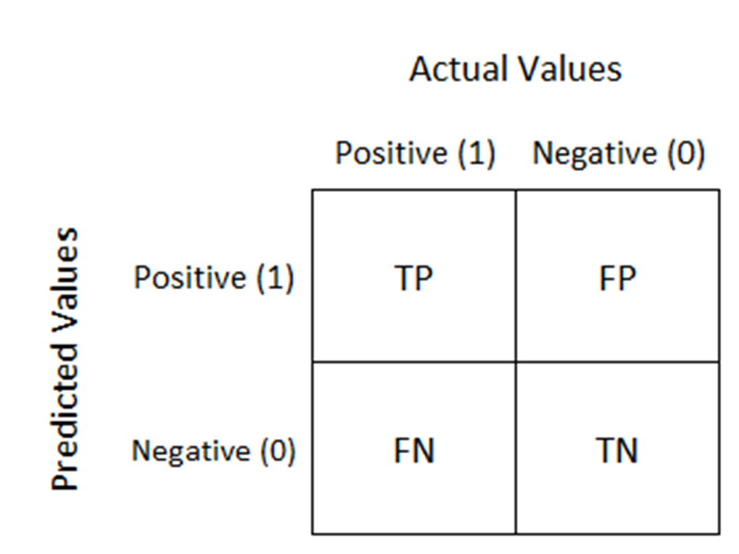
Evaluating Classifier - Confusion Matrix
A confusion matrix is a table that is often used to describe the performance of a classification model (or "classifier") on a set of test data for which the true values are known.

Slide 18
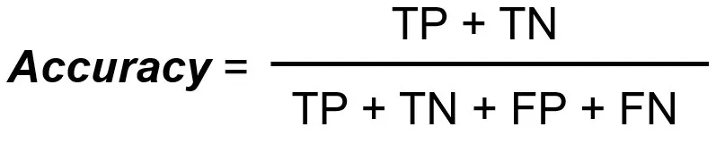
Accuracy

Slide 19
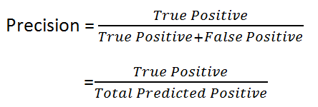
Precision
It is Also called Positive predictive value. The ratio of correct positive predictions to the total predicted positives
How many Positive value classifier correctly classified

Slide 20
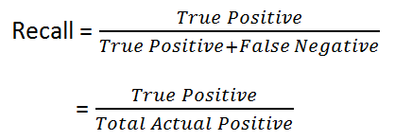
Recall
Recall is defined as the ratio of the total number of correctly classified positive classes divide by the total number of positive classes. Or, out of all the positive classes, how much we have predicted correctly. Recall should be high.

